Slide 1


Financial Dashboard Overview
This presentation focuses on the development of an interactive financial dashboard utilizing Tableau, designed to equip business stakeholders with vital insights into the company's financial performance. By highlighting key performance indicators, the dashboard aims to facilitate informed decision-making and enhance understanding of the company's financial health.

Slide 2
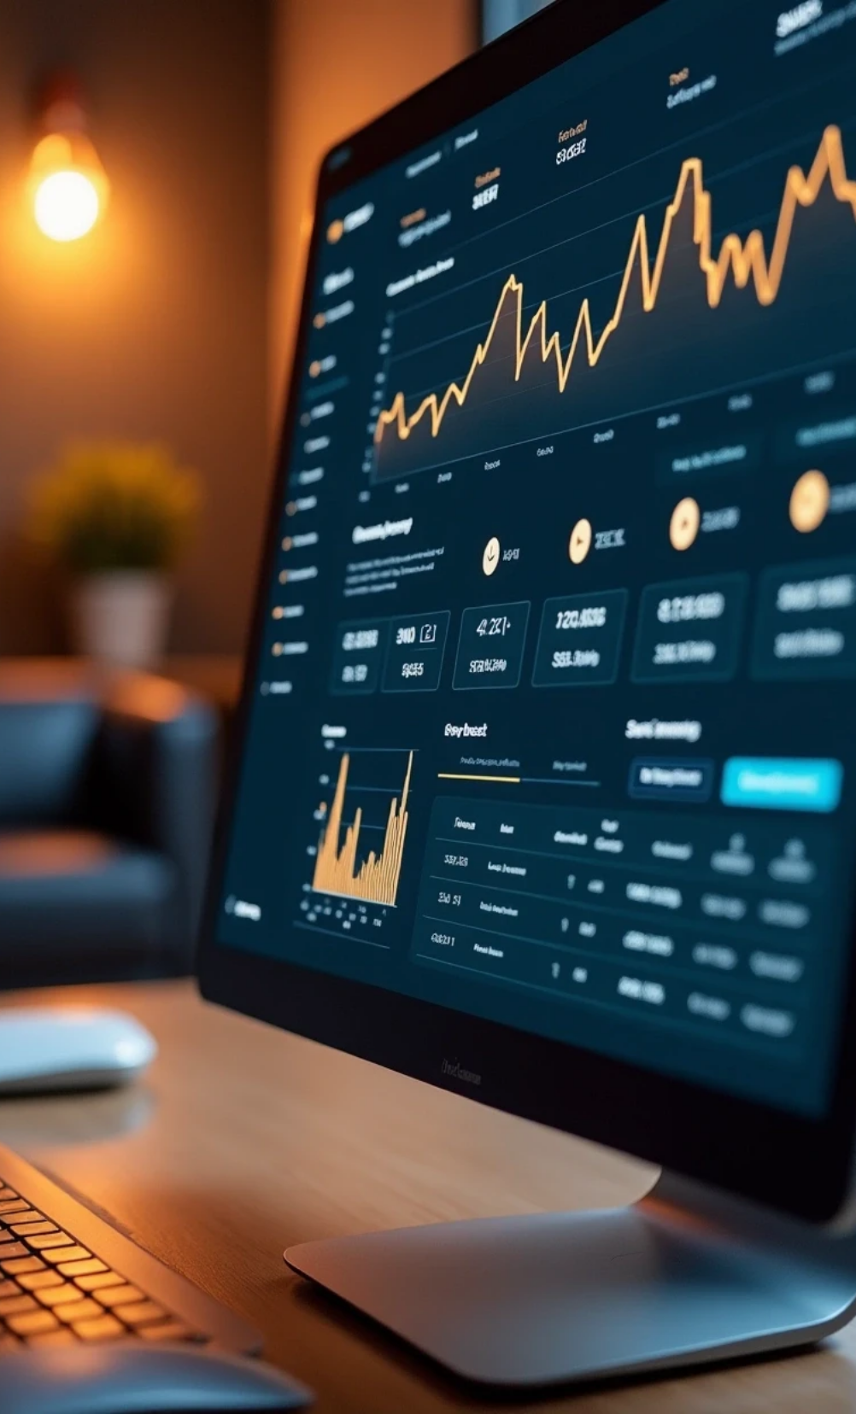


Interactive Financial Dashboard Design
1
Dashboard Objective
Create an interactive financial dashboard.
2
Key Metrics
Highlight Sales, Profit, and Growth.
3
Stakeholder Empowerment
Facilitate informed decision-making.

Slide 3




Tools & Dataset for Financial Analysis
2
Source of Dataset
The dataset is from Kaggle's extensive financial collection.
Data Visualization Tool
1
Utilize Tableau for interactive and user-friendly visualization.
Project Deliverables
An interactive dashboard and a PowerPoint summary for presentation.
3

Slide 4
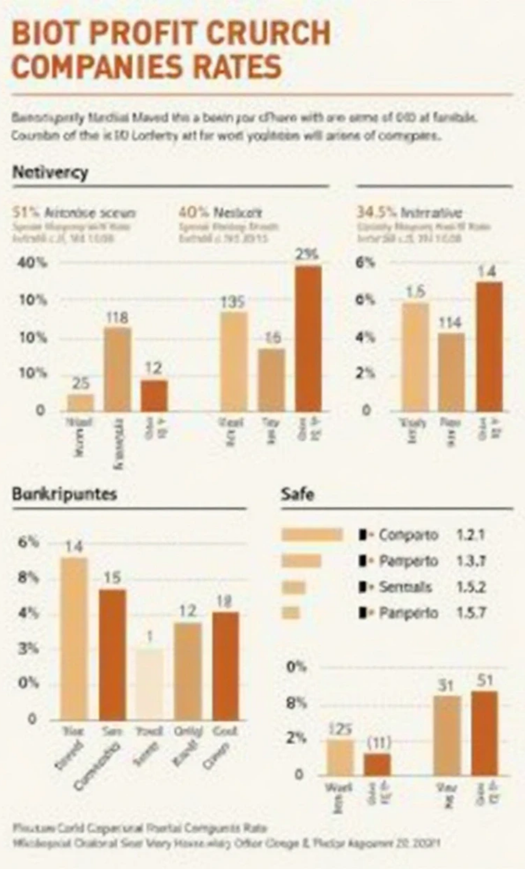


Dashboard Key Performance Indicators
Bankruptcy Status
Operating Profit Rate
Indicates if companies are Safe or Bankrupt.
Assesses the efficiency in generating profits from operations.
Continuous Net Profit Growth Rate
Net Value Growth Rate
Provides insights into the overall increase in company value.
Showcases sustained growth of net profits over time.
LINK -
https://public.tableau.com/views/data_analytics_dashboard/FinancialAnalysis?:language=en-US&:sid=&:redirect=auth&publish=yes&showOnboarding=true&:display_count=n&:origin=viz_share_link

Slide 5





Charts and Analysis Overview
1
2
3
Bankruptcy Status Chart
Growth Analysis
Trend and Continuous Growth KPI
Visually differentiate Safe (Green) vs Bankrupt (Red) companies.
Compare Profit Growth against Value Growth, highlighting key trends.
Indicate long-term performance trajectories.

Slide 6




Interactivity Features
Data Filters
Consistent Color Theme
The dashboard will feature filters allowing stakeholders to select data by Bankruptcy Status for more focused analysis.
1
2
A consistent color theme will be implemented across the dashboard, with Green denoting positive outcomes and Red indicating risks.
Intuitive Navigation
KPI Cards
The dashboard layout will be designed for intuitive navigation, enhancing user experience as stakeholders move through the analysis.
4
3
KPI Cards will be used to summarize values succinctly, making it easy to grasp essential metrics at a glance.

Slide 7

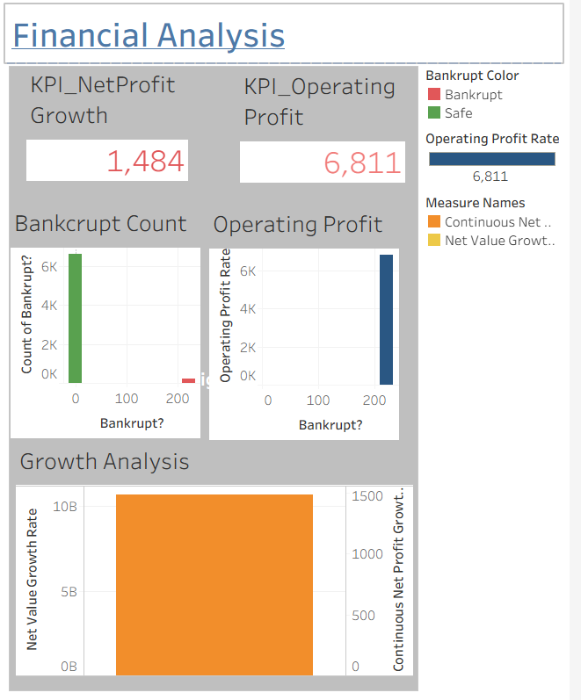

Final Dashboard View
1
Insert Screenshot
Insert screenshot of your Tableau dashboard here

Slide 8



Outcome / Conclusion
Quick Insights
The dashboard will provide stakeholders with quick and comprehensive insights into the company's financial health, facilitating timely decision-making.
Strategic Tool
It serves as a strategic tool to analyze risk and profitability, allowing for better financial management.
Transforming Data
This project demonstrates how Tableau can be leveraged to transform data into actionable business analytics, empowering stakeholders with the information they need.

